Slide 1

Menus: JMenuBar, JMenu, JMenuItem, JSeparator
Kyrshanlang R. Dkhar
MCA 5th Semester
Roll No: SACMC 15/01

Slide 2
What You Know

Slide 3
What You Will Learn

Slide 4
Introduction
Menus form an integral part of many applications because they present the program’s functionality to the user.

Slide 5
Introduction
The Swing menu system supports several key elements, including:
The menu bar, which is the main menu for an application.
The standard menu, which can contain either items to be selected or other menus(submenus).
The popup menu, which is usually activated by right-clicking the mouse.
The toolbar, which provides rapid access to program functionality, often paralleling menu items.
The action, which enables two or more different components to be managed by a single object. Actions are commonly used with menus and toolbars.

Slide 6
Steps To Create Menus
Create a JMenuBar object.
Create a JMenu object.
Create JMenuItem objects and add them to the JMenu object.
Add the JMenu object to the JMenuBar object.
For each JMenuItem, add an ActionListener that handles the action event fired when the menu item is selected.
Add JMenuBar to a frame via setJMenuBar().

Slide 7
SOURCE CODE
JMenuBar, JMenu, JMenuItem, JSeparator

Slide 8
Brief Explanation
JMenuBar is a container for menus.
It has only one constructor, which is the default constructor.
  JMenuBar jmb = new JMenuBar();
Each application has one and only one menu bar.
Methods:
  JMenu add(JMenu menu)
    E.g jmb.add(jmFile);
  void remove(JMenu menu)
  void remove(int idx) – idx is the index of the menu to remove
  int getMenuCount( ) - returns the number of elements contained within the menu bar.

Slide 9
Brief Explanation
JMenu encapsulates a menu, it is derived from JMenuItem.
  This means that one JMenu can be a selection in another JMenu.
  This enables one menu to be a submenu of another
Constructors:
  JMenu(String name) - This constructor creates a menu that has the title specified by name.
  JMenu() default constructor
Methods:
  JMenuItem add(JMenuItem item)
    E.g jmFile.add(jmiOpen);
  void remove(JMenuItem menu)
  void remove(int idx) – idx is the index of the MenuItem to remove
  void addSeparator( ) – adds a Separator to the JMenu
  void insertSeparator(int idx) - idx specifies the zero-based index at which the separator will be added.
  int getMenuComponentCount( ) - returns the number of items contained in the menu.

Slide 10
Brief Explanation
JMenuItem encapsulates an element in a menu.
  This element can be a selection linked to some program action, such as Save or Close, or it can cause a submenu to be displayed.
  JMenuItem is derived from AbstractButton, & every item in a menu can be thought of as a special kind of button.
  When a menu item is selected, an ActionEvent is generated.
Many Constructors:
  JMenuItem(String name)
    E.g JMenuItem jmiOpen= new JMenuItem(“Open”);
  JMenuItem(Icon image)
  JMenuItem(String name, Icon image)
  JMenuItem(String name, int mnem)
  JMenuItem()

Slide 11
Brief Explanation
Methods:
  setEnabled( ), which can be used to enable or disable a menu item, it is a function of AbstractButton.
  void setEnabled(boolean enable)

Slide 12
Brief Explanation
Jseparator: The visual separator between menu items.
Constructors:
  JSeparator() default constructor
    E.g JSeparator sep = new JSeparator();
    jmFile.add(Separator);

Slide 13

Questions

Slide 14
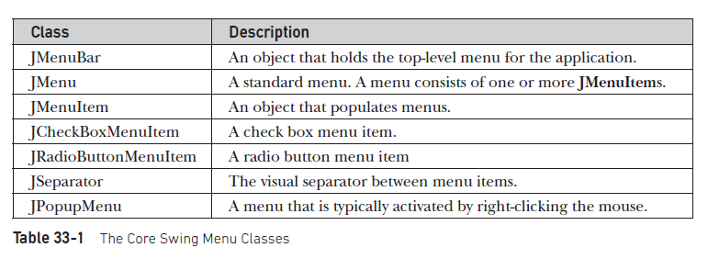
Core Swing Menu Classes

Slide 15
O/P

Slide 16
SOURCE CODE
JMenuBar, JMenu, JMenuItem, JSeparator:, JRB,JCB,POPUP,

Slide 17
Brief Explanation
Jseparator: The visual separator between menu items.
Constructors:
  JSeparator() default constructor
    E.g JSeparator sep = new JSeparator();
    jmFile.add(Separator);

Slide 18
Conclusion
The proposed system aims in making the work flow of managing Patient’s Details, Reports more efficient and easy for the administrators.
It also aims to ease and the computation of standardized values for the laboratory and region.
It will provide a user friendly interface to the Users of the System.

Slide 19
References
Java The Complete Reference Ninth Edition - Herbert Schildt – Page Number 1069

